Slide 1
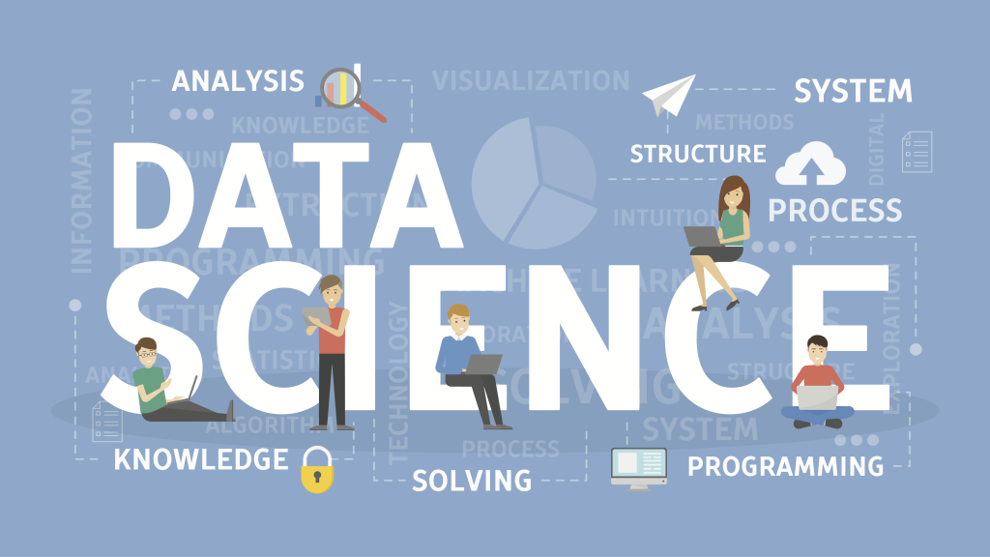
SHIELD TECHNOLOGIES
By:
Raju

Slide 2
?
?
what is Data Science
?
?

Slide 3
Definition
Data science is an inter-disciplinary field that uses scientific methods, processes, algorithms and systems to extract knowledge and insights from many structural and unstructured data.

Slide 4
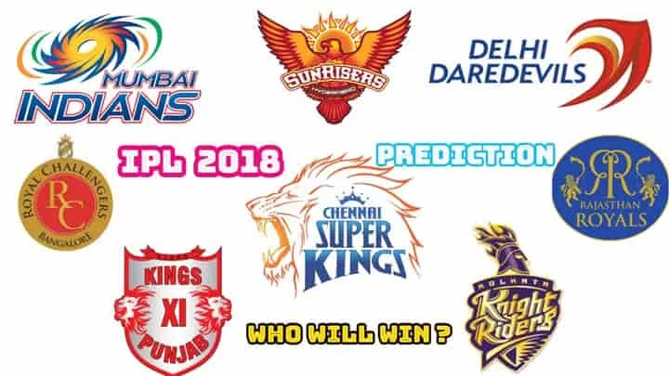
with an example
IPL WINNER PREDICTION

Slide 5
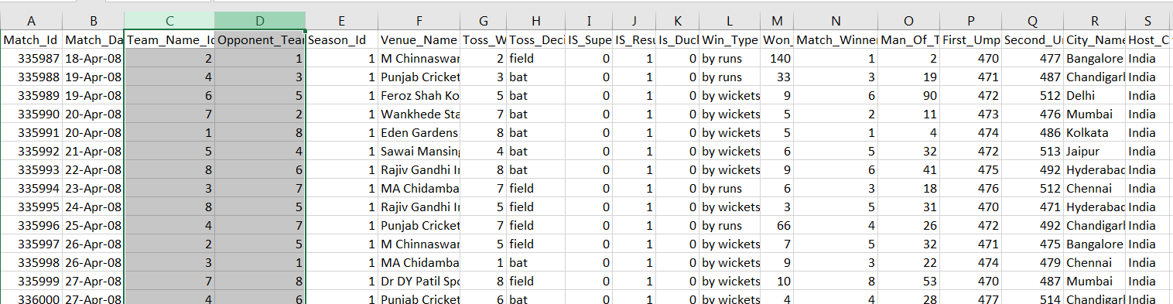
IPL Data Set

Slide 6
cont...
CS:python,matlab,r
maths:probability,arrays
Business:details about cricket

Slide 7
where else its been used today

Slide 8
THANK YOU

